Slide 1
Basics of
Machine Learning
Dmitry Ryabokon, github.com/dryabokon

Slide 2

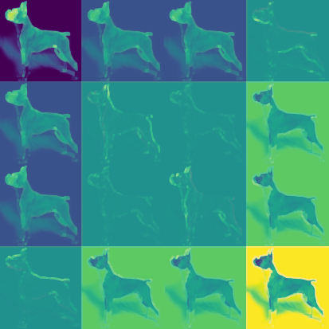
Lesson 17
Intro to Deep Learning

Slide 3
Intro to Deep Learning
Summary
CNNs out of box
Some datasets available for research
Basic Operations

Slide 4
CNNs out of box
The popular networks
Classification
LeNet Model
AlexNet Model
VGG Model
ResNet Paper
YOLO9000 Paper
DenseNet Paper
Segmentation
FCN8 Paper
SegNet Paper
U-Net Paper
E-Net Paper
ResNetFCN Paper
PSPNet Paper
Mask RCNN Paper
Detection
Faster RCNN Paper
SSD Paper
YOLOv2 Paper
R-FCN Paper

Slide 5

CNNs out of box
Some datasets available for research
MNIST: 10 classes, ~7000 ex. per class
ImageNet: 1000 classes, ~100 ex per class

Slide 6
CNNs out of box
Some datasets available for research
The Street View House Numbers
10 classes, ~2000 ex. per class
CIFAR: 10 classes, 6000 ex. per class
100 classes, 600 ex per class

Slide 7
CNNs out of box
Some datasets available for research
Olivetti database: 40 classes
.. and much more @ kaggle

Slide 8
CNNs out of box
ImageNet Classification error
XRCE
AlexNet
ZF
VGG
ResNet
GoogLeNet
GoogLeNet-v4

Slide 9
CNNs out of box
Usage of the neural networks
identify the name of a street (in France) from an image
compressing and decompressing images
semantic image segmentation
real-world image text extraction.
image classification
image-to-text
unsupervised learning
3D object reconstruction
image matching and retrieval
automatic speech recognition
localizing and identifying multiple objects in a single image
computer vision
discovery of latent 3D keypoints
predicting future video frames
https://github.com/keras-team/keras/tree/master/examples
https://github.com/tensorflow/models/tree/master/research

Slide 10
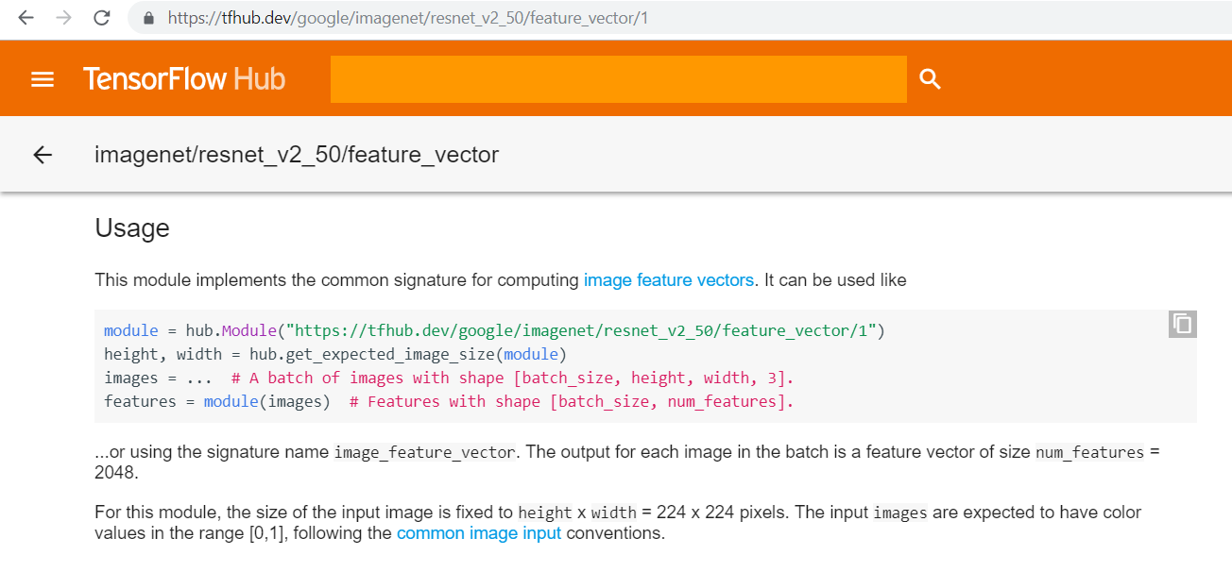
CNNs out of box

Slide 11
CNNs out of box
import tensorflow_hub as hub import urllib.request import cv2 import numpy import json import tensorflow as tf # ---------------------------------------------------------------------------------------------------------------------- URL = 'https://s3.amazonaws.com/deep-learning-models/image-models/imagenet_class_index.json' data = json.loads(urllib.request.urlopen(URL).read().decode()) class_names = [data['%d'%i][1] for i in range(0,999)] # ---------------------------------------------------------------------------------------------------------------------- def example_predict(): module = hub.Module("https://tfhub.dev/google/imagenet/resnet_v2_50/classification/1") img = cv2.imread('data/ex-natural/dog/dog_0000.jpg') img = cv2.cvtColor(img, cv2.COLOR_BGR2RGB) img = cv2.resize(img, (224, 224)).astype(numpy.float32) img = numpy.array([img]).astype(numpy.float32) / 255.0 sess = tf.Session() sess.run(tf.global_variables_initializer()) sess.run(tf.tables_initializer()) outputs = module(dict(images=img), signature="image_classification", as_dict=True) prob = outputs["default"].eval(session=sess)[0] idx = numpy.argsort(-prob)[0] print(class_names[idx], prob[idx]) sess.close() return # ---------------------------------------------------------------------------------------------------------------------- if __name__ == '__main__': example_predict()

Slide 12
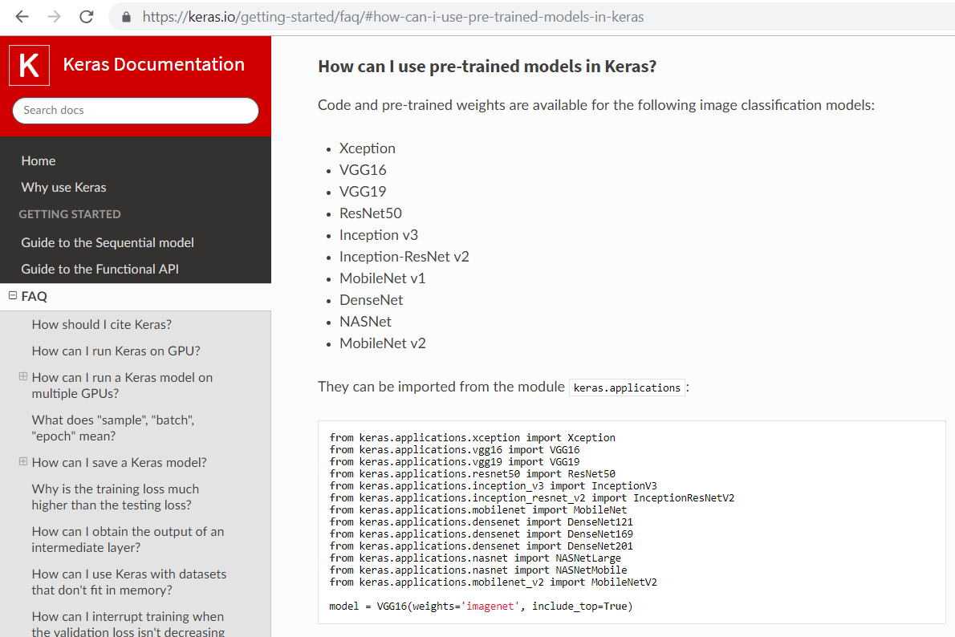
CNNs out of box

Slide 13
CNNs out of box
from keras.applications import MobileNet from keras.applications.xception import Xception from keras.applications.mobilenet import preprocess_input import urllib.request import cv2 import numpy import json from keras import backend as K K.set_image_dim_ordering('tf') # ---------------------------------------------------------------------------------------------------------------------- URL = 'https://s3.amazonaws.com/deep-learning-models/image-models/imagenet_class_index.json' data = json.loads(urllib.request.urlopen(URL).read().decode()) class_names = [data['%d'%i][1] for i in range(0,999)] # ---------------------------------------------------------------------------------------------------------------------- def example_predict(): CNN = MobileNet() #CNN = Xception() img = cv2.imread('data/ex-natural/dog/dog_0000.jpg') img = cv2.cvtColor(img, cv2.COLOR_BGR2RGB) img = cv2.resize(img, (224, 224)).astype(numpy.float32) prob = CNN.predict(preprocess_input(numpy.array([img]))) idx = numpy.argsort(-prob[0])[0] print(class_names[idx], prob[0, idx]) return # ---------------------------------------------------------------------------------------------------------------------- if __name__ == '__main__': example_predict()

Slide 14
Basic operations

Slide 15
Basic operations
Convolution

Slide 16

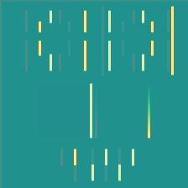
Basic operations
Convolution
=

Slide 17

Basic operations
Convolution
=

Slide 18

Basic operations
Convolution
=

Slide 19

Basic operations
Convolution
=

Slide 20
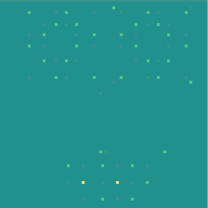
Basic operations
Convolution
=

Slide 21
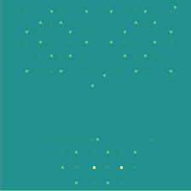
Basic operations
Convolution
=

Slide 22
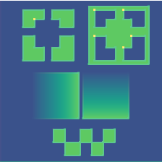
Basic operations
Convolution
=

Slide 23

Basic operations
Convolution
=

Slide 24
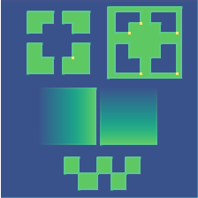
Basic operations
Convolution
=

Slide 25
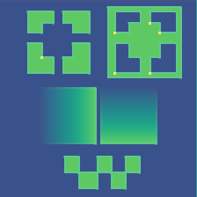
Basic operations
Convolution
=

Slide 26
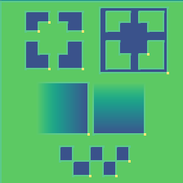
Basic operations
Convolution
=

Slide 27
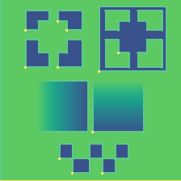
Basic operations
Convolution
=

Slide 28
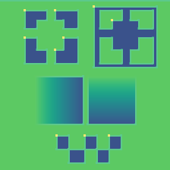
Basic operations
Convolution
=

Slide 29
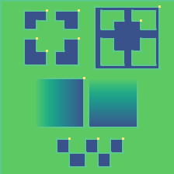
Basic operations
Convolution
=

Slide 30
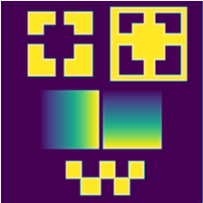
Basic operations
Convolution
=

Slide 31
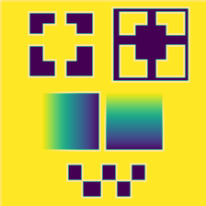
Basic operations
Convolution
=

Slide 32
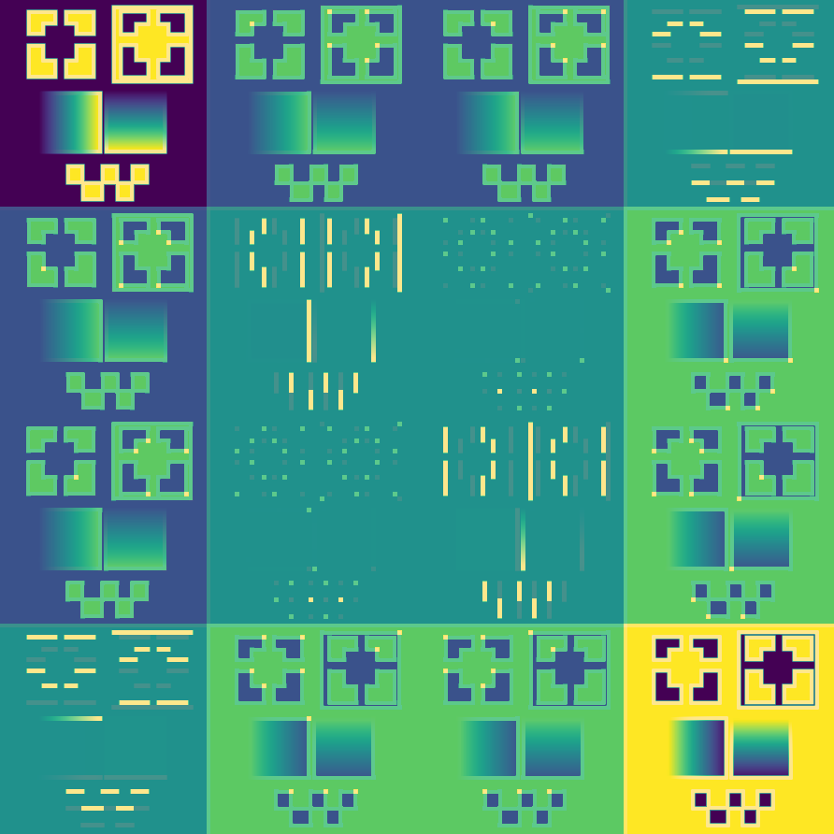
Basic operations
Convolution

Slide 33
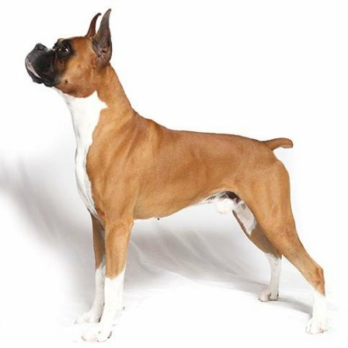
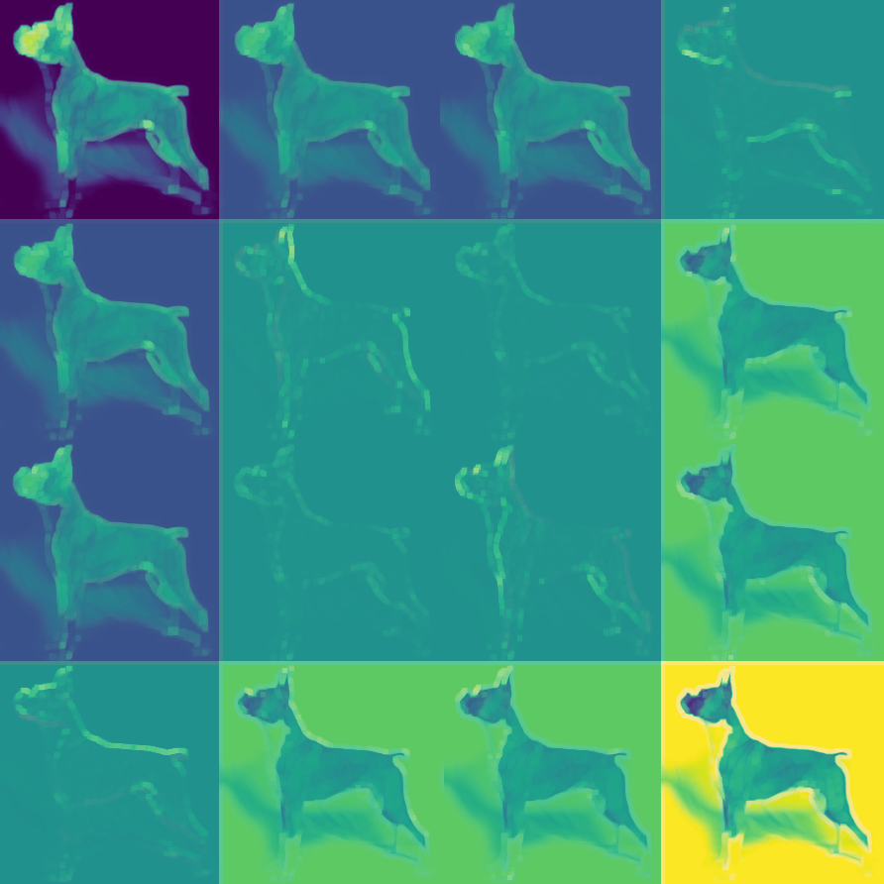
Basic operations
Convolution

Slide 34
Basic operations
De-Convolution

Slide 35
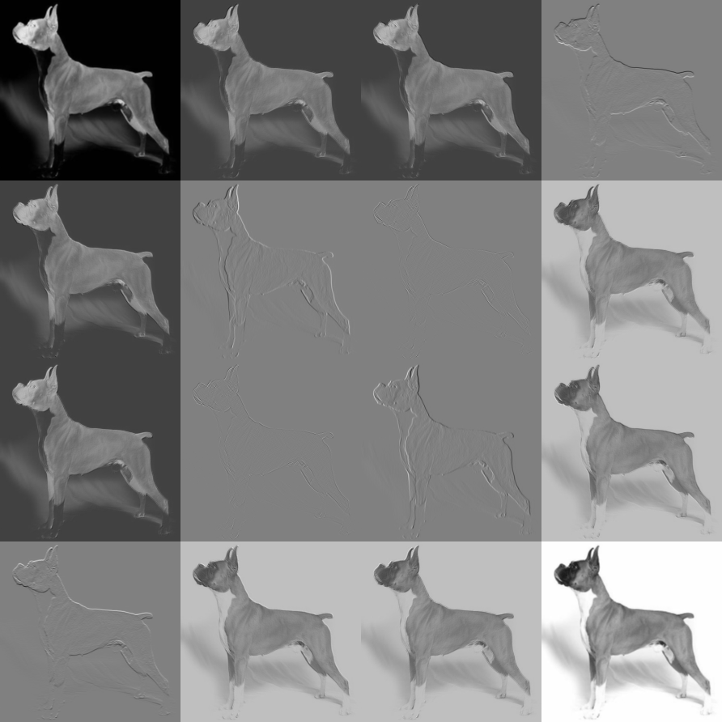
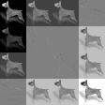
Basic operations
Pool: avg

Slide 36
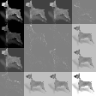
Basic operations
Pool: max

Slide 37
Basic operations
Flatten

Slide 38
Basic operations
Fully Connected

Slide 39
Basic operations
Dropout

Slide 40
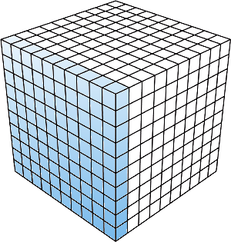
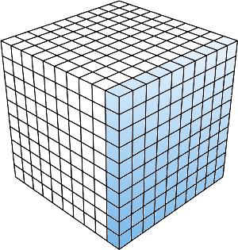
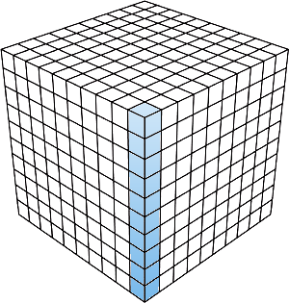
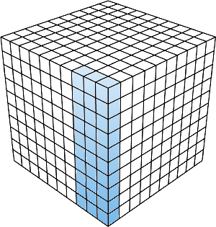
Basic operations
Normalization
layer
batch
instance
group

